Slide 1
Branston Junior Academy
Curriculum Overview, Progression
Document and Calculation Approaches

Slide 2
Additional guidance for extra support set:
Week 1: Revise prior learning- previous year KPIs (WS-Year 1/2 AK- Year 3/4) | Several following weeks (Length of WRM unit- approx): Using mixed year group planning and the scheme of learning common content document. Teach lower year group content (3 or 5) All children go off- TA and teacher focus on lower year group/ SEN (Early question approx. 1-3) Mid-lesson teacher calls back higher year group children (4 or 6) direct teach linked steps- they go and complete early question approx. 1-3 of higher year group or separate activity (teacher planned) while lower year group continue to work with TAs on next set of their question approx. 4-6 or separate activity (teacher planned) | Last Week: End of unit assessment- may be discussed and guided. Address misconceptions/ note for consolidation weeks

Slide 3
Year 3/4 Additional Support Set Learning Overview (Follow Green unit)
TERM | Week 1 | Week 2 | Week 3 | Week 4 | Week 5 | Week 6
Autumn 1 | Number: Place Value |  |  |  | Number: Addition and Subtraction
Autumn 2 | Number: Addition and Subtraction |  | Number: Multiplication and Division
Spring 1 | Number: Multiplication and Division |  | Measurement: Length and Perimeter |  | Number: Fractions | Number: Fractions
Spring 2 | Number: Fractions |  | Measurement: Mass and Capacity includes other measure areas in KPI Orange unit |  |  | Measurement: Money (additional unit)
Summer 1 | Number: Decimals- only included in year 4 (No KPIs) |  |  | Measurement: Time | Measurement: Time | Statistics
Summer 2 | Statistics | Geometry: Position and Direction Geometry Shape |  | Geometry: Shape (Orange unit) |  | Consolidation/ Transition
Calculation Guidance | Addition | Subtraction | Multiplication | Division

Slide 4
Year 3 Learning Overview
TERM | Week 1 | Week 2 | Week 3 | Week 4 | Week 5 | Week 6
Autumn 1 | Number: Place Value |  |  | Number: Addition and Subtraction
Autumn 2 | Number: Addition and Subtraction |  | Number: Multiplication and Division |  |  | Consolidation/ Summative Assessment
Spring 1 | Number: Multiplication and Division |  |  | Measurement: Money | Statistics
Spring 2 | Measurement: Length and Perimeter |  |  | Number: Fractions |  | Consolidation/ Summative Assessment
Summer 1 | Number: Fractions |  |  | Measurement: Time
Summer 2 | Geometry: Properties of Shape |  | Measurement: Mass and Capacity |  |  | Consolidation/ Summative Assessment
Calculation Guidance | Addition | Subtraction | Multiplication | Division

Slide 5
Year 4 Learning Overview
TERM | Week 1 | Week 2 | Week 3 | Week 4 | Week 5 | Week 6
Autumn 1 | Number: Place Value |  |  |  | Number: Addition and Subtraction
Autumn 2 | Number: Addition and Subtraction | Measurement: Length and Perimeter | Number: Multiplication and Division |  |  | Consolidation/ Summative Assessment
Spring 1 | Number: Multiplication and Division |  |  | Measurement: Area | Number: Fractions
Spring 2 | Number: Fractions |  | Number: Decimals |  |  | Consolidation/ Summative Assessment
Summer 1 | Number: Decimals |  | Measurement: Money |  | Statistics
Summer 2 | Measurement: Time | Geometry: Properties of shape |  |  | Geometry: Position and Direction | Consolidation/ Transition
Calculation Guidance | Addition | Subtraction | Multiplication | Division

Slide 6
Year 5/6 Additional Support group Learning Overview (Follow Blue Unit)
TERM | Week 1 | Week 2 | Week 3 | Week 4 | Week 5 | Week 6
Autumn 1 | Place Value (Originally 2 week unit) |  |  | Negative Numbers- No prior KPIs part of Year 5/6 place value (Purple unit) | Four Operations Add and Subtract
Autumn 2 | Four Operations Multiply and Divide |  |  | Fractions
Spring 1 | Fractions | Converting Units | Ratio (Year 6)- No prior KPIs |  | Algebra (Year 6)
 |  |  | Time (Year 5) |  | Money (Year 5)
Spring 2 | Decimals |  | Fractions, decimals and % |  | Area, perimeter and volume
Summer 1 | Statistics (originally two week unit) | Properties of shape |  | Position and Direction | Statistics
Summer 2 | Year 5 Gap Analysis
Calculation Guidance | Addition | Subtraction | Multiplication | Division

Slide 7
Year 5 Learning Overview
TERM | Week 1 | Week 2 | Week 3 | Week 4 | Week 5 | Week 6
Autumn 1 | Number: Place Value |  |  | Number: Addition and Subtraction |  | Statistics
Autumn 2 | Statistics | Number: Multiplication and Division |  | Measurement: Perimeter and Area |  | Consolidation/ Summative Assessment
Spring 1 | Number: Multiplication and Division |  |  | Number: Fractions
Spring 2 | Number: Fractions |  |  | Number: decimals and percentages |  | Consolidation/ Summative Assessment
Summer 1 | Number: Decimals |  |  |  | Geometry: Properties of shape
Summer 2 | Geometry: Properties of shape | Geometry: Position and Direction | Measuring: Converting units |  | Measuring: volume | Consolidation/ Transition
Calculation Guidance | Addition | Subtraction | Multiplication | Division

Slide 8
Year 6 Learning Overview
TERM | Week 1 | Week 2 | Week 3 | Week 4 | Week 5 | Week 6
Autumn 1 | Number: Place Value |  | Number: Addition and Subtraction
 |  |  | Multiplication and Division
Autumn 2 | Number: Fractions |  |  |  | Geometry: position and direction | Consolidation/ Summative Assessment
Spring 1 | Number: Decimals |  | Number: Percentages |  | Number: Algebra
Spring 2 | Measuring: Converting units | Measurement: Perimeter, Area and Volume |  | Number: Ratio and proportion |  | Consolidation/ Summative Assessment
Summer 1 | Geometry: properties of shape |  | Statistics |  | Problem Solving
Summer 2 | Investigations |  |  |  |  | Consolidation/ Transition
Calculation Guidance | Addition | Subtraction | Multiplication | Division

Slide 9
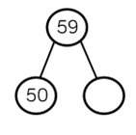
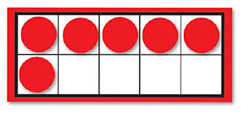
Number: Place Value: Year 3/4 Additional Support group (Revise these KPIs before moving on to year 3/4 content)
Year group | LOs | Key Vocab | Models/ Images and Methods
Year 1 KPIs Year 2 KPIs | count to and across 100, forwards and backwards, beginning with 0 or 1, or from any given number count, read and write numbers to 100 in numerals; count in multiples of twos, fives and tens given a number, identify one more and one less count in steps of 2, 3, and 5 from 0, and in tens from any number, forward and backward Compare and order numbers from 0 up to 100; use <, > and = signs use place value and number facts to solve problems. | Tens Ones Place value grid Partition More Fewer Fewest Greatest Smallest | Dienes Blocks Tactile objects (eg counting camels, shells, beads etc) Cubes Bead strings Tens frame Real life groups of 10 (straws, pencil etc) Digit cards Arrow cards Tactile numbers
Tens | Ones
Counting | Comparing numbers | Identifying, representing and estimating numbers | Reading and writing numbers
Understanding place value | Rounding | Problem Solving

Slide 10
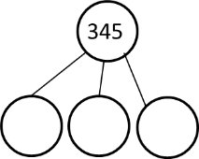
Number: Place Value: Yr3/4
Year group | LOs | Key Vocab | Models/ Images and Methods
Year 3 | count from 0 in multiples of 4, 8, 50 and 100 find 10 or 100 more or less than a given number recognise the place value of each digit in a three-digit number (hundreds, tens, ones) compare and order numbers up to 1000 identify, represent and estimate numbers using different representations read and write numbers up to 1000 in numerals and in words solve number problems and practical problems involving these ideas. | Hundreds Tens Ones Place value More Less Greater than (>) Less than (<) equal to Compare Estimate Exchange | Dienes blocks Place Value counters Arrow cards Real-life representations
Year 4 | count in multiples of 6, 7, 9, 25 and 1000 find 1000 more or less than a given number count backwards through zero to include negative numbers recognise the place value of each digit in a four-digit number (thousands, hundreds, tens, and ones) order and compare numbers beyond 1000 § identify, represent and estimate numbers using different representations round any number to the nearest 10, 100 or 1000 solve number and practical problems that involve all of the above and with increasingly large positive numbers read Roman numerals to 100 (I to C) and know that over time, the numeral system changed to include the concept of zero and place value. | Tens Hundreds Thousands Rounding Order More than (>) Less that (<) partition Numerals Nearest Distance | Dienes Blocks Place Value counters Arrow Cards Digit cards Real life representations
H | T | O
H | T | O
Counting | Comparing numbers | Identifying, representing and estimating numbers | Reading and writing numbers
Understanding place value | Rounding | Problem Solving

Slide 11
Number: Place Value: Year 5/6 Additional Support group (Revise these KPIs before moving on to year 5/6 content) See previous year groups for models/ images and vocab
Year group | LOs
Year 3 KPIs Year 4 KPIs | count from 0 in multiples of 4, 8, 50 and 100 recognise the place value of each digit in a three-digit number (hundreds, tens, ones) solve number problems and practical problems involving these ideas. count in multiples of 6, 7, 9, 25 and 1000 count backwards through zero to include negative numbers order and compare numbers beyond 1000 round any number to the nearest 10, 100 or 1000
Counting | Comparing numbers | Identifying, representing and estimating numbers | Reading and writing numbers
Understanding place value | Rounding | Problem Solving

Slide 12
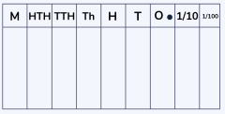
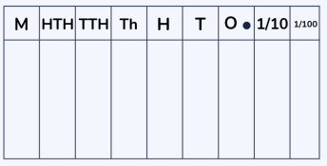
Number: Place Value: Yr5/6
Year group | LOs | Key Vocab | Models/ Images and Methods
Year 5 | read, write, order and compare numbers to at least 1 000 000 and determine the value of each digit count forwards or backwards in steps of powers of 10 for any given number up to 1 000 000 interpret negative numbers in context, count forwards and backwards with positive and negative whole numbers, including through zero round any number up to 1 000 000 to the nearest 10, 100, 1000, 10 000 and 100 000 solve number problems and practical problems that involve all of the above read Roman numerals to 1000 (M) and recognise years written in Roman numerals. | Ones Tens Hundreds Thousands Ten thousands Place Value Partition Estimate Round Compare Order Equivalent Greater than (>) Less than (<) Convert | Part part whole model Number lines Place value grids- counters, number cards Dienes blocks Real-life representations of number (crate, boxes, packs)
Year 6 | read, write, order and compare numbers up to 10 000 000 and determine the value of each digit round any whole number to a required degree of accuracy use negative numbers in context, and calculate intervals across zero solve number and practical problems that involve all of the above. | Ten thousands Hundred thousands Millions Ten million Place value Partition Order Rounding Negative Positive | Place value grids- counters, number cards Positive numbers and positive/ negative number lines Part Part whole model Dienes blocks (as decimals)
Counting | Comparing numbers | Identifying, representing and estimating numbers | Reading and writing numbers
Understanding place value | Rounding | Problem Solving

Slide 13
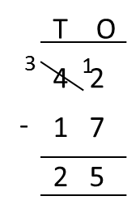
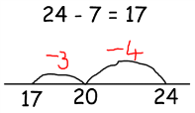
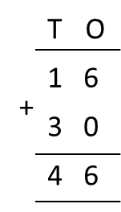
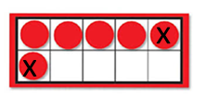
Number: Addition and Subtraction: Year 3/4 Additional Support group (Revise these KPIs before moving on to year 3/4 content)
Year group | LOs | Key Vocab | Models/ Images and Methods
Year 1 KPIs Year 2 KPIs | represent and use number bonds and related subtraction facts within 20 solve problems with addition and subtraction: using concrete objects and pictorial representations, including those involving numbers, quantities and measures applying their increasing knowledge of mental and written methods recall and use addition and subtraction facts to 20 fluently, and derive and use related facts up to 100 | Altogether In total Plus Add Fact family Number sentence Number bonds Column 10 more 10 less Total Tens Ones Subtract Difference Bar model represent How many are left? Take away Subtract Count backwards How many more How many fewer Difference | Numberline Part part whole model Combining counters and items Tens frame Bead strings Dienes blocks Hundred square Column Column Bar models
Number bonds
Mental Calculation
Written Methods
Inverse operations, estimating and check answers
Problem Solving

Slide 14
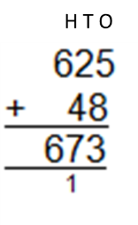
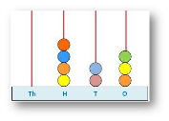
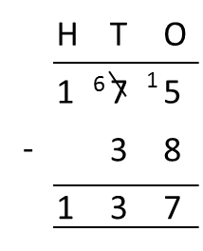
Number: Addition and Subtraction: Yr3
Year group | LOs | Key Vocab | Models/ Images and Methods
Year 3 | add and subtract numbers mentally, including: a three-digit number and ones a three-digit number and tens a three-digit number and hundreds add and subtract numbers with up to three digits, using formal written methods of columnar addition and subtraction estimate the answer to a calculation and use inverse operations to check answers solve problems, including missing number problems, using number facts, place value, and more complex addition and subtraction. | Addition Subtraction Mental method Column method Exchange Menal method Estimate Approximate Digits Multiple | Diene blocks Partitioning grids Numberline Part Part whole Bead strings Place value counters/ beads Arrow cards Function machines Bar models
Number bonds
Mental Calculation
Written Methods
Inverse operations, estimating and check answers
Problem Solving
H | T | O

Slide 15
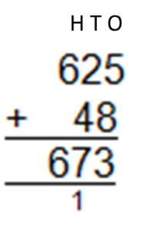
Number: Addition and Subtraction: Yr4
Year group | LOs | Key Vocab | Models/ Images and Methods
Year 4 | add and subtract numbers with up to 4 digits using the formal written methods of columnar addition and subtraction where appropriate estimate and use inverse operations to check answers to a calculation solve addition and subtraction two-step problems in contexts, deciding which operations and methods to use and why. | Addition Total More than Subtraction Less than Column method Estimate How much Strategy Efficient Accurate Exact Fact Diagram | Part Part Whole Place value grid Place Value counters Bar models Column Addition and Subtraction Dienes blocks
Number bonds
Mental Calculation
Written Methods
Inverse operations, estimating and check answers
Problem Solving
H | T | O

Slide 16
Number: Addition and Subtraction: Year 5/6 Additional Support group (Revise these KPIs before moving on to year 5/6 content) See previous year groups for models/ images and vocab
Year groups | LOs
Year 3 KPIs Year 4 KPIs | add and subtract numbers mentally, including: a three-digit number and ones a three-digit number and tens a three-digit number and hundreds solve addition and subtraction two-step problems in contexts, deciding which operations and methods to use and why.
Number bonds | Written Methods | Problem Solving
Mental Calculation | Inverse operations, estimating and check answers

Slide 17
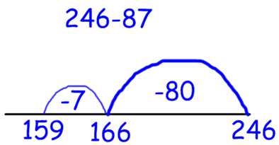
Number: Addition and Subtraction: Yr5
Year group | LOs | Key Vocab | Models/ Images and Methods
Year 5 | add and subtract whole numbers with more than 4 digits, including using formal written methods (columnar addition and subtraction) add and subtract numbers mentally with increasingly large numbers use rounding to check answers to calculations and determine, in the context of a problem, levels of accuracy solve addition and subtraction multi-step problems in contexts, deciding which operations and methods to use and why. | Add Subtract Ones (1s) Tens (10s) Hundreds (100s) Thousands (1000s) Ten thousands (10,000s) Mentally Inverse Round Estimate Distance chart | Column addition and subtraction Bar models Place value grid Place value counters Part Part Whole Numberline
Number bonds
Mental Calculation
Written Methods
Inverse operations, estimating and check answers
Problem Solving
H | T | O

Slide 18
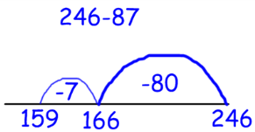
Number: Addition and Subtraction: Yr6
Year group | LOs | Key Vocab | Models/ Images and Methods
Year 6 | perform mental calculations, including with mixed operations and large numbers use their knowledge of the order of operations to carry out calculations involving the four operations solve addition and subtraction multi-step problems in contexts, deciding which operations and methods to use and why solve problems involving addition, subtraction, multiplication and division use estimation to check answers to calculations and determine, in the context of a problem, an appropriate degree of accuracy. | Order of operations Column addition Column subtraction Estimate | Column addition Column subtraction Place value grid Place value counters Numberline
Number bonds
Mental Calculation
Written Methods
Inverse operations, estimating and check answers
Problem Solving
H | T | O

Slide 19
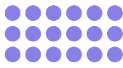
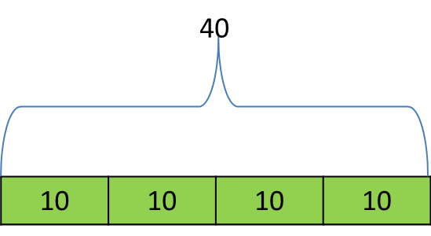
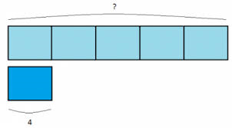
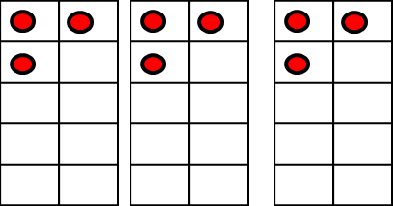
Number: Multiplication and Division: Year 3/4 Additional Support group (Revise these KPIs before moving on to year 3/4 content)
Year group | LOs | Key Vocab | Models/ Images and Methods
Year 1 KPIs Year 2 KPIs | NO YEAR 1 KPIs recall and use multiplication and division facts for the 2, 5 and 10 multiplication tables, including recognising odd and even numbers solve problems involving multiplication and division, using materials, arrays, repeated addition, mental methods, and multiplication and division facts, including problems in contexts. | Equal groups Array Column Row Double Twice Multiplication Times-tables Times Divide Division Share Group Odd Even | Arrays Number line Circles with ‘lots of’ objects in Real life examples- choc bars, tables round chairs, bowls of fruit Singapore bars Counters and grouping Tens frame Repeated groups
Multiplication and Division Facts
Mental Calculation
Written Calculation
Properties of Numbers
Order of operations
Inverse Operations, estimating and checking answers
Solve Problems

Slide 20
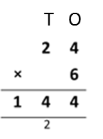
Number: Multiplication and DivisionYr3
Year group | LOs | Key Vocab | Models/ Images and Methods
Year 3 | recall and use multiplication and division facts for the 3, 4 and 8 multiplication tables write and calculate mathematical statements for multiplication and division using the multiplication tables that they know, including for two-digit numbers times one-digit numbers, using mental and progressing to formal written methods solve problems, including missing number problems, involving multiplication and division, including positive integer scaling problems and correspondence problems in which n objects are connected to m objects. | Equal Multiply Divide Times-tables Sharing Grouping Array Bar model Remainder Repeated addition Multiplication sentence Division statement Division fact Equal and unequal groups Multiplication Division Statement Number sentence Compare More than Less than (<) Greater than (>) Equal Equally Least Most Partition Multi-step | Arrays Numberlines Sharing objects in circles Repeated groups Hundred squares Cubes Real life examples (spider for 8s, pack of pens, cats legs, pair of socks etc.) Part Part Whole Place value counters Dienes Bar models for problem solving Short x
Multiplication and Division Facts
Mental Calculation
Written Calculation
Properties of Numbers
Order of operations
Inverse Operations, estimating and checking answers
Solve Problems
Please note: Power Maths introduce a two-step short division method not mentioned in the NC. Please avoid.

Slide 21
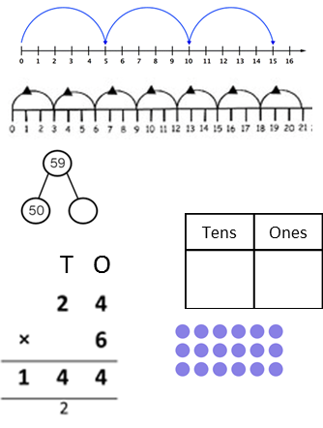
Number: Multiplication and Division: Yr4
Year group | LOs | Key Vocab | Models/ Images and Methods
Year 4 | recall multiplication and division facts for multiplication tables up to 12 × 12 use place value, known and derived facts to multiply and divide mentally, including: multiplying by 0 and 1; dividing by 1; multiplying together three numbers recognise and use factor pairs and commutativity in mental calculations multiply two-digit and three-digit numbers by a one-digit number using formal written layout solve problems involving multiplying and adding, including using the distributive law to multiply two digit numbers by one digit, integer scaling problems and harder correspondence problems such as n objects are connected to m objects. | Multiply Divide Multiplication fact Division fact Lots of Groups of Times-tables Array Partition Bar model Remainder Factor pair Factors Commutative | Numberline Array Dienes Place value grids and counters Tens frames Real life examples to demonstrate times tables (pair of socks, spiders, cats legs etc.) Part part whole Bar model Singapore bar for problem solving Short x
Multiplication and Division Facts
Mental Calculation
Written Calculation
Properties of Numbers
Order of operations
Inverse Operations, estimating and checking answers
Solve Problems

Slide 22
Number: Multiplication and Division: Year 5/6 Additional Support group (Revise these KPIs before moving on to year 5/6 content) See previous year groups for models/ images and vocab
Year group | LOs
Year 3 KPIs Year 4 KPIs | recall and use multiplication and division facts for the 3, 4 and 8 multiplication tables write and calculate mathematical statements for multiplication and division using the multiplication tables that they know, including for two-digit numbers times one-digit numbers, using mental and progressing to formal written methods recall multiplication and division facts for multiplication tables up to 12 × 12
Multiplication and Division Facts | Written Calculation | Order of operations | Problem Solving
Mental Calculation | Properties of Numbers | Inverse Operations, estimating and checking answers

Slide 23
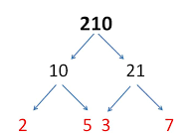
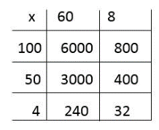
Number: Multiplication and Division: Yr5
Year group | LOs | Key Vocab | Models/ Images and Methods
Year 5 | identify multiples and factors, including finding all factor pairs of a number, and common factors of two numbers know and use the vocabulary of prime numbers, prime factors and composite (non-prime) numbers establish whether a number up to 100 is prime and recall prime numbers up to 19 multiply numbers up to 4 digits by a one- or two-digit number using a formal written method, including long multiplication for two-digit numbers multiply and divide numbers mentally drawing upon known facts divide numbers up to 4 digits by a one-digit number using the formal written method of short division and interpret remainders appropriately for the context multiply and divide whole numbers and those involving decimals by 10, 100 and 1000 recognise and use square numbers and cube numbers, and the notation for squared (2) and cubed (3) solve problems involving multiplication and division including using their knowledge of factors and multiples, squares and cubes solve problems involving addition, subtraction, multiplication and division and a combination of these, including understanding the meaning of the equals sign solve problems involving multiplication and division, including scaling by simple fractions and problems involving simple rates. | Prime number Composite number Square number Cube number Square abbreviation Cubed abbreviation Inverse operation Multiply Divide Multiple Factor Prime factor Place value Partition Equal Remainder | Times table square Arrays to display remainders Hundred square Partition and recombine Factor tree diagram Dienes blocks Place value grids and counters Grid method Long multiplication Short division Number line division Singapore bars for problem solving
Multiplication and Division Facts
Mental Calculation
Written Calculation
Properties of Numbers
Order of operations
Inverse Operations, estimating and checking answers
Problem Solving

Slide 24
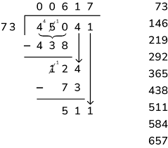
Number: Multiplication and Division: Yr6
Year group | LOs | Key Vocab | Models/ Images and Methods
Year 6 | multiply multi-digit numbers up to 4 digits by a two-digit whole number using the formal written method of long multiplication divide numbers up to 4 digits by a two-digit whole number using the formal written method of long division, and interpret remainders as whole number remainders, fractions, or by rounding, as appropriate for the context divide numbers up to 4 digits by a two-digit number using the formal written method of short division where appropriate, interpreting remainders according to the context perform mental calculations, including with mixed operations and large numbers identify common factors, common multiples and prime numbers use their knowledge of the order of operations to carry out calculations involving the four operations solve problems involving addition, subtraction, multiplication and division use estimation to check answers to calculations and determine, in the context of a problem, an appropriate degree of accuracy. | Column multiplication Short division Long division Remainder Factor Estimate | Place value grid and counters Grid method Short multiplication Long multiplication Short division Bar models Chunking Arrays Times tables squares
Multiplication and Division Facts
Mental Calculation
Written Calculation
Properties of Numbers
Order of operations
Inverse Operations, estimating and checking answers
Solve Problems

Slide 25
Number: Fractions: Year 3/4 Additional Support group (Revise these KPIs before moving on to year 3/4 content)
Year group | LOs | Key Vocab | Models/ Images and Methods
Year 1 KPIs Year 2 KPIs | recognise, find and name a half as one of two equal parts of an object, shape or quantity recognise, find, name and write fractions 1/3, 1/4, 2/4, 3/4, and of a length, shape, set of objects or quantity | Half Halves Quarter Third Equivalent Equal part Numerator Denominator Fraction bar Non-unit fraction Unit fraction | Half/quarter of shapes Half/ quarter of a line Half/ quarter of a quantity (visual and concrete) Half/ quarter as capacity Bar model Fractions on a numberline Fraction wall Cuisenaire rods
Counting in fractional steps
Recognising Fractions
Comparing Fractions
Comparing Decimals
Rounding including decimals
Equivalence
+ and - fractions
x and ÷ fractions
x and ÷ decimals
Problem Solving

Slide 26
Number: Fractions: Yr3
Year group | LOs | Key Vocab | Models/ Images and Methods
Year 3 | count up and down in tenths; recognise that tenths arise from dividing an object into 10 equal parts and in dividing one-digit numbers or quantities by 10 recognise, find and write fractions of a discrete set of objects: unit fractions and non-unit fractions with small denominators recognise and use fractions as numbers: unit fractions and non-unit fractions with small denominators recognise and show, using diagrams, equivalent fractions with small denominators add and subtract fractions with the same denominator within one whole [for example, + = ] compare and order unit fractions, and fractions with the same denominators solve problems that involve all of the above. | Equal Parts Whole Unit fraction Equation Integer Non-unit fraction Numerator Denominator Represent Share Group Mixed number Whole number Divide Set of objects Multiply Tenth Interval Equivalent Compare Add Subtract Greater than (>) Less than (<) Equal to Multiply Divide Difference Inequality statement | Numberline (both blank and labelled) Bar model Shape diagram Fractions of set of objects (concrete and pictorial) Cuisenaire rods Fraction wall/ fraction wall tiles
Counting in fractional steps
Recognising Fractions
Comparing Fractions
Comparing Decimals
Rounding including decimals
Equivalence
+ and - fractions
x and ÷ fractions
x and ÷ decimals
Problem Solving
And opposite with ÷

Slide 27
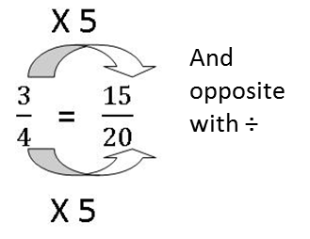
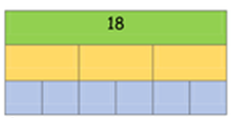
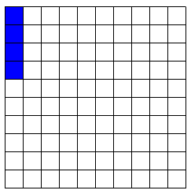
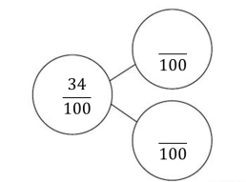
Number: Fractions (including decimals): Yr4
Year group | LOs | Key Vocab | Models/ Images and Methods
Year 4 | recognise and show, using diagrams, families of common equivalent fractions count up and down in hundredths; recognise that hundredths arise when dividing an object by one hundred and dividing tenths by ten. solve problems involving increasingly harder fractions to calculate quantities, and fractions to divide quantities, including non-unit fractions where the answer is a whole number add and subtract fractions with the same denominator recognise and write decimal equivalents of any number of tenths or hundredths recognise and write decimal equivalents to 1/4 , 1/2 , 3/4 find the effect of dividing a one- or two-digit number by 10 and 100, identifying the value of the digits in the answer as ones, tenths and hundredths round decimals with one decimal place to the nearest whole number compare numbers with the same number of decimal places up to two decimal places solve simple measure and money problems involving fractions and decimals to two decimal places. | Tenths Hundredths Equivalent Simplify Numerator Denominator Fraction Mixed number Improper fraction Simplest fraction Add Subtract Improper fractions Mixed number Fraction of an amount Tens Ones Decimal Point Tenths Hundredths Greater than Equivalent Less than Decimal 0.1 and 0.01 Centimetre Millimetre Rounding Equal to Order Compare Convert Ascending Descending | Hundredths grid Fraction and decimal part part whole model Fraction numberline (labelled and unlabelled) Fraction wall Mixed representations of fractions- parts of shape, sets of object, number representations Bar model Place value grid and counters Dienes blocks Number line 0-1 etc. ruler
Counting in fractional steps
Recognising Fractions
Comparing Fractions
Comparing Decimals
Rounding including decimals
Equivalence
+ and - fractions
x and ÷ fractions
x and ÷ decimals
Problem Solving

Slide 28
Number: Fractions (including decimal and %): Year 5/6 Additional Support group (Revise these KPIs before moving on to year 5/6 content) see previous year groups for models/images and vocab
Year group | LOs
Year 3 KPIs (Fractions) Year 4KPIs (Fraction and Decimals) | count up and down in tenths; recognise that tenths arise from dividing an object into 10 equal parts and in dividing one-digit numbers or quantities by 10 recognise, find and write fractions of a discrete set of objects: unit fractions and non-unit fractions with small denominators recognise and show, using diagrams, equivalent fractions with small denominators recognise and show, using diagrams, families of common equivalent fractions count up and down in hundredths; recognise that hundredths arise when dividing an object by one hundred and dividing tenths by ten. round decimals with one decimal place to the nearest whole number solve simple measure and money problems involving fractions and decimals to two decimal places.
Counting in fractional steps | Comparing Fractions | Rounding including decimals | + and - fractions | x and ÷ decimals
Recognising Fractions | Comparing Decimals | Equivalence | x and ÷ fractions | Problem Solving

Slide 29
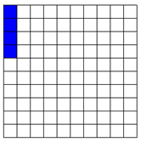
Number: Fractions (including decimals and %): Yr5
Year group | LOs | Key Vocab | Models/ Images and Methods
Year 5 | compare and order fractions whose denominators are all multiples of the same number identify, name and write equivalent fractions of a given fraction, represented visually, including tenths and hundredths recognise mixed numbers and improper fractions and convert from one form to the other and write mathematical statements > 1 as a mixed number [for example, + = = 1 ] add and subtract fractions with the same denominator and denominators that are multiples of the same number multiply proper fractions and mixed numbers by whole numbers, supported by materials and diagrams read and write decimal numbers as fractions [for example, 0.71 = ] recognise and use thousandths and relate them to tenths, hundredths and decimal equivalents round decimals with two decimal places to the nearest whole number and to one decimal place read, write, order and compare numbers with up to three decimal places solve problems involving number up to three decimal places recognise the per cent symbol (%) and understand that per cent relates to ‘number of parts per hundred’, and write percentages as a fraction with denominator 100, and as a decimal solve problems which require knowing percentage and decimal equivalents of 1/2, 1/4, 1/5, 2/5, 4/5 and those fractions with a denominator of a multiple of 10 or 25. | Equivalent Numerator Denominator Whole Fraction Simplify Expand Division Improper Mixed number Convert Sequence Order Greater than (>) Less than (<) Equal to Add Subtract Proper fraction Simplify Equivalent Efficient Common denominator Decimal Decimal place Tenths Hundreths Thousandths Decimal point Place value Digits Per cent (%) Percentages Multiply Divide Column Exchange Digit | Bar model Representing fractions in different ways (shapes, amounts, numberline, numerical) Fraction wall Cuisenaire rods Fraction strips Place value chart and counters Equivalent number lines Decimal number lines Dienes blocks Part part whole decimal model
Counting in fractional steps
Recognising Fractions
Comparing Fractions
Comparing Decimals
Rounding including decimals
Equivalence
+ and - fractions
x and ÷ fractions
x and ÷ decimals
Problem Solving

Slide 30
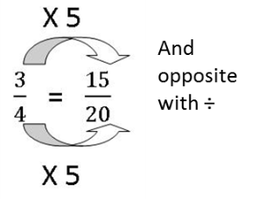
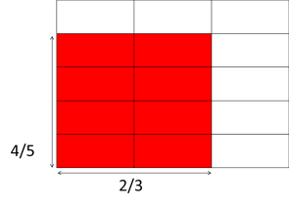
Number: Fractions (including decimals and %): Yr6
Year group | LOs | Key Vocab | Models/ Images and Methods
Year 6 | use common factors to simplify fractions; use common multiples to express fractions in the same denomination compare and order fractions, including fractions > 1 add and subtract fractions with different denominators and mixed numbers, using the concept of equivalent fractions multiply simple pairs of proper fractions, writing the answer in its simplest form divide proper fractions by whole numbers associate a fraction with division and calculate decimal fraction equivalents [for example, 0.375] for a simple fraction [for example 3/8 ] identify the value of each digit in numbers given to three decimal places and multiply and divide numbers by 10, 100 and 1000 giving answers up to three decimal places multiply one-digit numbers with up to two decimal places by whole numbers use written division methods in cases where the answer has up to two decimal places solve problems which require answers to be rounded to specified degrees of accuracy recall and use equivalences between simple fractions, decimals and percentages, including in different contexts. | Numerator Denominator Common denominator Common factor Equivalent Simplify Simplest form Factor Highest common factor Lowest common multiple Compare Order Ascending Descending Proper fraction Improper fraction Mixed number Convert Lowest common denominator Equivalent Multiply Divide Decimal Decimal place (dp) Recurring Placeholder Place value Tenths, hundredths, thousandths Products Per cent (%) percentage Part/ share | Fraction strips Bar models Numberlines (blank and labelled) Multiply fractions grid Place value grids and counters Dienes blocks Cuisenaire rods Tens/ hundreths/ thousands grids to recognise equivalences
Counting in fractional steps
Recognising Fractions
Comparing Fractions
Comparing Decimals
Rounding including decimals
Equivalence
+ and - fractions
x and ÷ fractions
x and ÷ decimals
Problem Solving

Slide 31
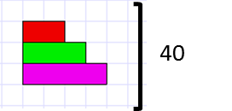
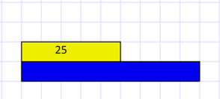
Number: Ratio and Proportion: Yr6
Year group | LOs | Key Vocab | Models/ Images and Methods
Year 6 | solve problems involving the relative sizes of two quantities where missing values can be found by using integer multiplication and division facts solve problems involving the calculation of percentages [for example, of measures, and such as 15% of 360] and the use of percentages for comparison solve problems involving similar shapes where the scale factor is known or can be found solve problems involving unequal sharing and grouping using knowledge of fractions and multiples. | Ratio Proportion Part Whole Scale Scale factor Similar notation | Box method Bar models Grouping with visual and concrete objects
Ration and Proportion -Year 6 only

Slide 32
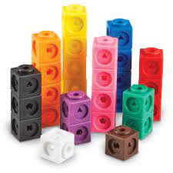
Number: Algebra: Yr6
Year group | LOs | Key Vocab | Models/ Images and Methods
Year 6 | express missing number problems algebraically find pairs of numbers that satisfy number sentences involving two unknowns enumerate all possibilities of combinations of two variables use simple formulae recognise when it is possible to use formulae for area and volume of shapes (copied from Measurement) generate and describe linear number sequences | Sequence Rule Term Algebra Expression Calculation Formula Substitute Generalise Operation Calculate Equation Inverse Solution | Function machines Bar models Cubes and scale
Equations
Formulae
Sequences

Slide 33
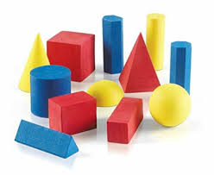
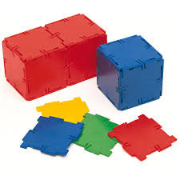
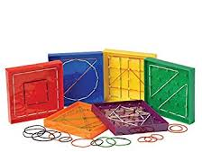
Geometry: Properties of Shape: Year 3/4 Additional Support group (Revise these KPIs before moving on to year 3/4 content)
Year group | LOs | Key Vocab | Models/ Images and Methods
Year 1 KPIs Year 2 KPIs | recognise and name common 2-D and 3-D shapes, including: 2-D shapes [for example, rectangles (including squares), circles and triangles] 3-D shapes [for example, cuboids (including cubes), pyramids and spheres]. compare and sort common 2-D and 3-D shapes and everyday objects. | 3d shape Cube Cuboid Sphere Pyramid Cylinder Cone 2d shape Circle Triangle Faces Pattern Quadrilateral Polygon Prism Hexagon Octagon Vertex Vertices Hemisphere Symmetry Line of symmetry Symmetrical Curved surface | Use of plastic shapes- 2d and 3d Rulers Geoboards Polydron
Identifying shapes and their properties
Drawing and construct
Comparing and classifying
Angles

Slide 34
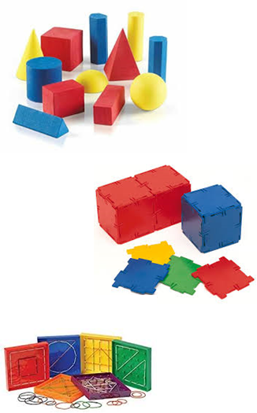
Geometry: Properties of Shape: Yr3
Year group | LOs | Key Vocab | Models/ Images and Methods
Year 3 | draw 2-D shapes and make 3-D shapes using modelling materials; recognise 3-D shapes in different orientations and describe them recognise angles as a property of shape or a description of a turn identify right angles, recognise that two right angles make a half-turn, three make three quarters of a turn and four a complete turn; identify whether angles are greater than or less than a right angle identify horizontal and vertical lines and pairs of perpendicular and parallel lines. | Right angle Acute Obtuse Right angle Parallel Perpendicular Vertical Horizontal Triangle Quadrilateral Kite Trapezium Rhombus Parallelogram Cuboid Triangular prism Square-based pyramid Cone Cylinder Sphere Edges Faces Vertices Clockwise Anticlockwise | Use of plastic shapes- 2d and 3d Rulers Geoboards Polydron Protractor (illustration purposes only)
Identifying shapes and their properties
Drawing and construct
Comparing and classifying
Angles

Slide 35
Geometry: Properties of Shape: Yr4
Year group | LOs | Key Vocab | Models/ Images and Methods
Year 4 | compare and classify geometric shapes, including quadrilaterals and triangles, based on their properties and sizes identify acute and obtuse angles and compare and order angles up to two right angles by size identify lines of symmetry in 2-D shapes presented in different orientations complete a simple symmetric figure with respect to a specific line of symmetry. | Quadrilateral Triangle Regular Irregular Interior angle Angle Acute Obtuse Reflect Right angle Symmetrical Isosceles Scalene Equivalent Line of symmetry Reflective symmetry | Use of plastic shapes- 2d and 3d Rulers Geoboards Polydron Protractor (illustration purposes only)
Identifying shapes and their properties
Drawing and construct
Comparing and classifying
Angles

Slide 36
Geometry: Properties of Shape: Year 5/6 Additional Support group (Revise these KPIs before moving on to year 5/6 content) see previous year groups for models/images and vocab
Year group | LOs
Year 3 KPIs Year 4 KPIs | identify right angles, recognise that two right angles make a half-turn, three make three quarters of a turn and four a complete turn; identify whether angles are greater than or less than a right angle compare and classify geometric shapes, including quadrilaterals and triangles, based on their properties and sizes identify lines of symmetry in 2-D shapes presented in different orientations
Identifying shapes and their properties | Drawing and construct | Comparing and classifying | Angles

Slide 37
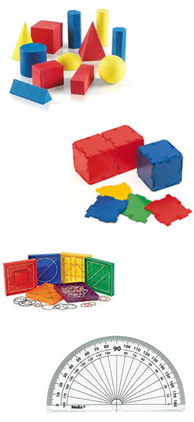
Geometry: Properties of Shape: Yr5
Year group | LOs | Key Vocab | Models/ Images and Methods
Year 5 | identify 3-D shapes, including cubes and other cuboids, from 2-D representations know angles are measured in degrees: estimate and compare acute, obtuse and reflex angles draw given angles, and measure them in degrees (o) Identify: angles at a point and one whole turn (total 360o) angles at a point on a straight line and a turn (total 180o) other multiples of 90o use the properties of rectangles to deduce related facts and find missing lengths and angles distinguish between regular and irregular polygons based on reasoning about equal sides and angles. | Parallel Perpendicular Angle Right angle Interior angle Quadrilateral View Regular Irregular 3D shape Pyramid Sphere Cone Hexagon Octagon Triangle Top view Plan view Side view | Use of plastic shapes- 2d and 3d Rulers Geoboards Polydron Protractor
Identifying shapes and their properties
Drawing and construct
Comparing and classifying
Angles

Slide 38
Geometry: Properties of Shape: Yr6
Year group | LOs | Key Vocab | Models/ Images and Methods
Year 6 | draw 2-D shapes using given dimensions and angles recognise, describe and build simple 3-D shapes, including making nets compare and classify geometric shapes based on their properties and sizes and find unknown angles in any triangles, quadrilaterals, and regular polygons illustrate and name parts of circles, including radius, diameter and circumference and know that the diameter is twice the radius recognise angles where they meet at a point, are on a straight line, or are vertically opposite, and find missing angles. | Degree Angle Obtuse Acute Reflex Right angle Protractor Triangle Isoceles Equilateral Scalene Regular Polygon Quadrilateral Parallelogram Kite Rhombus Trapezium Diameter Radius Circumference Concentric Perimeter Net Pyramid Tetrahedron Cylinder Prism Vertically Opposite angle Cuboid Cube | Use of plastic shapes- 2d and 3d Rulers Geoboards Polydron Protractor
Identifying shapes and their properties
Drawing and construct
Comparing and classifying
Angles

Slide 39
Geometry: Position and Direction: Year 3/4 Additional Support group (Revise these KPIs before moving on to year 3/4 content)
Year group | LOs | Key Vocab | Models/ Images and Methods
Year 1 KPIs Year 2 KPIs | NO YR1 KPIs use mathematical vocabulary to describe position, direction and movement, including movement in a straight line and distinguishing between rotation as a turn and in terms of right angles for quarter, half and three-quarter turns (clockwise and anti-clockwise). | Turn Half turn Quarter turn Three-quarter turn Whole turn Position Left Right Forwards Backwards Above Below Top Middle Bottom Up Down In-between Clockwise Anti-clockwise Forwards Backwards Left Right Middle | Physical activities Visual images Clock faces
Position, direction and movement
Pattern

Slide 40
Geometry: Position and Direction: Yr4
Year group | LOs | Key Vocab | Models/ Images and Methods
Year 4 | describe positions on a 2-D grid as coordinates in the first quadrant describe movements between positions as translations of a given unit to the left/right and up/down plot specified points and draw sides to complete a given polygon. | Position Horizontal Vertical Up Down Left Right Coordinate Square Rectangle Plot Vertex Vertices Point Grid | Physical activities Visual images
Position, direction and movement
Pattern

Slide 41
Geometry: Position and Direction: Year 5/6 Additional Support group (Revise these KPIs before moving on to year 5/6 content) see previous year groups for models/images and vocab
Year group | LOs
Year 3 KPIs Year 4 KPIs | No YR3 KPIs plot specified points and draw sides to complete a given polygon.
Position, direction and movement | Pattern

Slide 42
Geometry: Position and Direction: Yr5
Year group | LOs | Key Vocab | Models/ Images and Methods
Year 5 | identify, describe and represent the position of a shape following a reflection or translation, using the appropriate language, and know that the shape has not changed. | Reflection Translation Vertex Vertices Coordinates Mirror line Horizontal axis Vertical axis | Physical activities Visual images
Position, direction and movement
Pattern

Slide 43
Geometry: Position and Direction: Yr6
Year group | LOs | Key Vocab | Models/ Images and Methods
Year 6 | describe positions on the full coordinate grid (all four quadrants) draw and translate simple shapes on the coordinate plane, and reflect them in the axes. | Quadrant Four quadrants Translate Translation X-axis Y-axis Axis Axes Horizontal Vertical Vertex Reflect Reflection | Physical activities Visual images
Position, direction and movement
Pattern

Slide 44
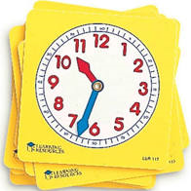
Measurement: Time: Year 3/4 Additional Support group (Revise these KPIs before moving on to year 3/4 content)
Year group | LOs | Key Vocab | Models/ Images and Methods
Year 1 KPIs Year 2 KPIs | compare, describe and solve practical problems for: time (time) tell the time to the hour and half past the hour and draw the hands on a clock face to show these times. NO YR 2 KPIs | Before After Yesterday Today Tomorrow Day Week Slower Faster Month Year Calendar Date Minute hand Hour hand o’clock Half past Quarter past Quarter to Minute hand Hour hand Duration Second Minute Hour | Calendars Plastic clocks Visuals of different types of clocks Numberline Part part whole method Bar model
Comparing and estimating
Measuring and calculating
Telling the time
Converting

Slide 45
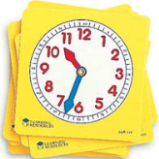
Measurement: Time: Yr3
Year group | LOs | Key Vocab | Models/ Images and Methods
Year 3 | tell and write the time from an analogue clock, including using Roman numerals from I to XII, and 12-hour and 24-hour clocks estimate and read time with increasing accuracy to the nearest minute; record and compare time in terms of seconds, minutes and hours; use vocabulary such as o’clock, a.m./p.m., morning, afternoon, noon and midnight (time) know the number of seconds in a minute and the number of days in each month, year and leap year(time) compare durations of events(time) | Month Year Midnight Midday Am Pm Duration Estimate Consecutive Hour Minute Second Past To Start End Duration Digital Analogue | Calendars Plastic clocks Digital clocks Visuals of different types of clocks- roman numerals, no numbers, 12,3,6,9 example etc. Numberline Bar model
Comparing and estimating
Measuring and calculating
Telling the time
Converting

Slide 46
Measurement: Time: Yr4
Year group | LOs | Key Vocab | Models/ Images and Methods
Year 4 | Convert between different units of measure (e.g. hour to minute) (time) read, write and convert time between analogue and digital 12- and 24-hour clocks (time) solve problems involving converting from hours to minutes; minutes to seconds; years to months; weeks to days. (time) | Convert Compare Units of time Seconds Minutes Hours Days Weeks Months Years 12-hour 24-hour Analogue Digital am/pm | Calendars Plastic clocks Digital clocks Visuals of different types of clocks- roman numerals, no numbers, 12,3,6,9 example etc. Numberline Bar model
Comparing and estimating
Measuring and calculating
Telling the time
Converting

Slide 47
Measurement: Time: Year 5/6 Additional Support group (Revise these KPIs before moving on to year 5/6 content)see previous year groups for models/images and vocab
Year group | LOs
Year 3 KPIs Year 4 KPIs | tell and write the time from an analogue clock, including using Roman numerals from I to XII, and 12-hour and 24-hour clocks Convert between different units of measure (e.g. hour to minute) (time)
Comparing and estimating | Measuring and calculating | Telling the time | Converting

Slide 48
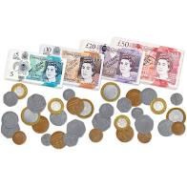
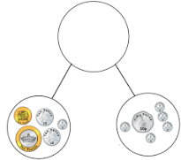
Measurement: Money: Year 3/4 Additional Support group (Revise these KPIs before moving on to year 3/4 content)
Year group | LOs | Key Vocab | Models/ Images and Methods
Year 1 KPIs Year 2 KPIs | NO YR 1 KPIs solve simple problems in a practical context involving addition and subtraction of money of the same unit, including giving change | Pound (£) Pence Coins Notes P Change | Plastic coins/ notes Numberline Part part whole model Bar model
Comparing and estimating
Measuring and calculating
Telling the time
Converting

Slide 49
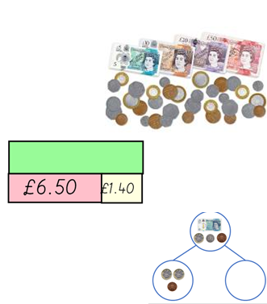
Measurement: Money: Yr3
Year group | LOs | Key Vocab | Models/ Images and Methods
Year 3 | add and subtract amounts of money to give change, using both £ and p in practical contexts | Pounds (£) Pence (p) Convert Total Difference | Plastic coins and notes Formal written methods Bar model Numberline Part part whole
Comparing and estimating
Measuring and calculating
Telling the time
Converting

Slide 50
Measurement: Money: Yr4
Year group | LOs | Key Vocab | Models/ Images and Methods
Year 4 | estimate, compare and calculate different measures, including money in pounds and pence | Notes Coins Pounds (£) Pence (p) Add Subtract Change Round to the nearest Order Greater than (>) Less than (<) Cheaper More expensive Estimate Over estimate Under estimate Notation Total | Plastic coins and notes Formal written methods Bar model Numberline Part part whole
Comparing and estimating
Measuring and calculating
Telling the time
Converting

Slide 51
Measurement: Money: Year 5/6 Additional Support group (Revise these KPIs before moving on to year 5/6 content)see previous year groups for models/images and vocab
Year group | LOs
Year 3 KPIs Year 4 KPIs | add and subtract amounts of money to give change, using both £ and p in practical contexts NO YR4 KPIs
Comparing and estimating | Measuring and calculating | Telling the time | Converting

Slide 52
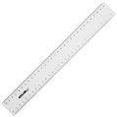
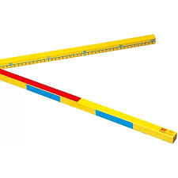
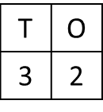
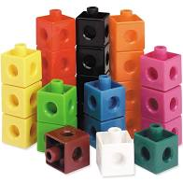
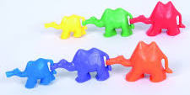
Measurement: Length and Height: Year 3/4 Additional Support group (Revise these KPIs before moving on to year 3/4 content)
Year group | LOs | Key Vocab | Models/ Images and Methods
Year 1 KPIs Year 2 KPIs | compare, describe and solve practical problems for: lengths and heights [for example, long/short, longer/shorter, tall/short, double/half] NO YR2 KPIs | Long, longer, longest Short, shorter, shortest Tall, taller, tallest Measure Length Centimetres Cm Metres Longer Shorter metre sticks Height Width Compare Distance | Non standard units of measure Rulers Metre sticks Numberlines Place value grid Bar model
Comparing and estimating
Measuring and calculating
Telling the time
Converting

Slide 53
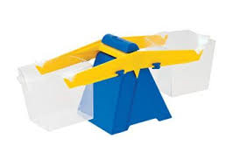
Measurement: Weight, Volume and Temperature: Year 3/4 Additional Support group (Revise these KPIs before moving on to year 3/4 content)
Year group | LOs | Key Vocab | Models/ Images and Methods
Year 1 LOs Year 2 LOs | compare, describe and solve practical problems for: lengths and heights capacity and volume [for example, full/empty, more than, less than, half, half full, quarter] mass/weight [for example, heavy/light, heavier than, lighter than] NO YR2 KPIs | Heavier Heaviest Lighter Lightest Capacity Balance scales Full Empty Compare Weight Weigh Balanced Measure Estimate Mass Balance Weighing scales Grams, g Kilogram, kg Litres, l Millilitres, ml Volume Temperature Thermometer Degrees Celsius Estimate Approximation | Balance scales Containers for capacity Informal units of measure Tens frames Part part whole model Weight g/kg Weighing scales Numberlines Thermometers- real and drawn
Comparing and estimating
Measuring and calculating
Telling the time
Converting

Slide 54
Measurement: Length and Perimeter: Yr3
Year group | LOs | Key Vocab | Models/ Images and Methods
Year 3 | measure, compare, add and subtract: lengths (m/cm/mm) measure the perimeter of simple 2-D shapes | Length Height Width Perimeter Distance Centimetres (cm) Millimetres (mm) Metres (m) Unit of measurement Measure Add Subtract Multiply Equivalent Convert Greater than (>) Less than (<) Ruler Metre stick | Numerline Dienes blocks Metre stick Ruler Part part whole Formal written methods Bar model
Comparing and estimating
Measuring and calculating
Telling the time
Converting

Slide 55
Measurement: Mass and Capacity: Yr3
Year group | LOs | Key Vocab | Models/ Images and Methods
Year 3 | measure, compare, add and subtract:: mass (kg/g); volume/capacity (l/ml) | Mass Weigh Measure Scale Interval Grams (g) Kilograms (kg) Capacity Litre (l) Millilitre (ml) Scale Interval Convert | Weighing scales Balance scales Weights Numberline Part part whole model Bar model Varying containers Measuring jugs Equivalence bar models
Comparing and estimating
Measuring and calculating
Telling the time
Converting
1300ml
1050ml | ?

Slide 56
Measurement: Area: Yr4
Year group | LOs | Key Vocab | Models/ Images and Methods
Year 4 | Find the area of rectilinear shapes by counting squares | Length Width Area Space Rectangle Square Rectilinear shape Unit Least Greatest Triangle Quadrilateral Reflection Rotation | geoboards and elastic bands Shapes drawn on cm2 paper Example of rectilinear and non rectilinear shapes.
Comparing and estimating
Measuring and calculating
Telling the time
Converting

Slide 57
Measurement: Length and Perimeter: Yr4
Year group | LOs | Key Vocab | Models/ Images and Methods
Year 4 | Convert between different units of measure measure and calculate the perimeter of a rectilinear figure (including squares) in centimetres and metres | Length Width Perimeter Distance Rectangle Square Rectilinear shape Centimetre (cm) Metre (m) Kilometre (km) Equivalent to | Numberline Bar diagram equivalents Shapes drawn on cm2 paper Shapes drawn with given dimensions
Comparing and estimating
Measuring and calculating
Telling the time
Converting

Slide 58
Measurement: Length, Perimeter, Area and Volume : Year 5/6 Additional Support group (Revise these KPIs before moving on to year 5/6 content)see previous year groups for models/images and vocab
Year groups | LOs
Year 3 KPIs Year 4 KPIs | measure, compare, add and subtract: lengths (m/cm/mm) convert between different units of measure
Comparing and estimating | Measuring and calculating | Telling the time | Converting

Slide 59
Measurement: Perimeter and Area: Yr5
Year group | LOs | Key Vocab | Models/ Images and Methods
Year 5 | measure and calculate the perimeter of composite rectilinear shapes in centimetres and metres calculate and compare the area of rectangles (including squares), and including using standard units, square centimetres (cm2) and square metres (m2) and estimate the area of irregular shapes estimate volume [for example, using 1 cm3 blocks to build cuboids (including cubes)] and capacity [for example, using water] | Perimeter Distance Area Space Length Width Centimetres Square centimetres (cm2) Metres Square metres (m2) Scale Compare Estimate Formula 2d shape Brackets | A range of rectilinear and compound shapes- missing and given values- different scale (mm, cm, m), different orientations, missing parts- lots of variance questions. Opportunities to estimate area on a square grid
Comparing and estimating
Measuring and calculating
Telling the time
Converting

Slide 60
Measurement: Volume: Yr5
Year group | LOs | Key Vocab | Models/ Images and Methods
Year 5 | estimate volume [for example, using 1 cm3 blocks to build cuboids (including cubes)] and capacity [for example, using water] | Volume Cube Cuboid 3d shape Solid Capacity Calculate Estimate Unit cubes Least Greatest | Multilink cubes A range of differing capacity containers (varying shapes) 3d shapes
Comparing and estimating
Measuring and calculating
Telling the time
Converting

Slide 61
Measurement: Perimeter, Area and Volume: Yr6
Year group | LOs | Key Vocab | Models/ Images and Methods
Year 6 | solve problems involving the calculation of units of measure, using decimal notation up to three decimal places where appropriate recognise that shapes with the same areas can have different perimeters and vice versa recognise when it is possible to use formulae for area and volume of shapes calculate the area of parallelograms and triangles calculate, estimate and compare volume of cubes and cuboids using standard units, including cubic centimetres (cm3) and cubic metres (m3), and extending to other units [for example, mm3 and km3]. | Area Volume Perimeter Parallelogram Height Enclosed Width Length Square centimetres (cm2) Square metres (m2) Base Estimate Formula Compound shape Cubic centimetres (cm3) Cubic metres (m3) | A range of rectilinear and compound shapes- missing and given values- different scale (mm, cm, m), different orientations, missing parts- lots of variance questions. Varying shapes to compare area and perimeter (triangles, parallelograms) Perimeter of varying regular and irregular shapes Opportunities to estimate area on a square grid Opportunities to compare area Geoboards and elastic bands Cubes Cubes and cuboid visual with given and missing values
Comparing and estimating
Measuring and calculating
Telling the time
Converting

Slide 62
Measurement: Converting Units+ Mass and Capacity : Year 5/6 Additional Support group (Revise these KPIs before moving on to year 5/6 content) see previous year groups for models/images and vocab
Year group | LOs
Year 3 KPIs Year 4 KPIs (taken from length and perimeter unit) | measure, compare, add and subtract:: mass (kg/g); volume/capacity (l/ml) convert between different units of measure (e.g. kilometre to metre; hour to minute)
Comparing and estimating | Measuring and calculating | Telling the time | Converting

Slide 63
Measurement: Converting Units: Yr5
Year group | LOs | Key Vocab | Models/ Images and Methods
Year 5 | convert between different units of metric measure (for example, kilometre and metre; centimetre and metre; centimetre and millimetre; gram and kilogram; litre and millilitre) understand and use approximate equivalences between metric units and common imperial units such as inches, pounds and pints solve problems involving converting between units of time use all four operations to solve problems involving measure [for example, length, mass, volume, money] using decimal notation, including scaling. | Convert Metric units Imperial units Kilo Kilogram Gram Millimetre Centimetre Metre Kilometre Litre Millilitre Pound (lb) Ounce (oz) Inch (in) Foot (ft) Yard (yd) Pint Gallon Stone (st) Approximately Timetable | Use of a range measuring equipment- scales, containers, rulers, metre sticks, etc. Singapore bar models for conversion Place value grid for conversion Conversion scales Clocks- drawn and physical Example timetables Numberline to solve time problems
Comparing and estimating
Measuring and calculating
Telling the time
Converting

Slide 64
Measurement: Converting Units: Yr6
Year group | LOs | Key Vocab | Models/ Images and Methods
Year 6 | solve problems involving the calculation and conversion of units of measure, using decimal notation up to three decimal places where appropriate use, read, write and convert between standard units, converting measurements of length, mass, volume and time from a smaller unit of measure to a larger unit, and vice versa, using decimal notation to up to three decimal places convert between miles and kilometres | Metric Imperial Units of measurement Grams (g) Kilograms (kg) Pounds (lbs) Ounces (oz) Mass Millilitres (ml) Litres (l) Capacity Pints Millimetres (mm) Centimetres (cm) Metres (m) Kilometres (km) Inches (in) Feet (ft) Yards Miles Length Convert Conversion table Conversion graph | Use of a range measuring equipment- scales, containers, rulers, metre sticks, etc. Conversion graph Conversion table Bar models Bar models for conversion
Comparing and estimating
Measuring and calculating
Telling the time
Converting

Slide 65
Statistics: Year 3/4 Additional Support group (Revise these KPIs before moving on to year 3/4 content)
Year group | LOs | Key Vocab | Models/ Images and Methods
Year 1 KPIs Year 2 KPIs | NO YR1 KPIs ask and answer questions about totalling and comparing categorical data. | Tally chart Pictogram Key | A range of different visual images of relevant graphs/ charts/ tables- vary structure and presentation as much as possible. Use of numberline to count tally
Interpreting, constructing and presenting data
Solving Problems

Slide 66
Statistics:Yr3
Year group | LOs | Key Vocab | Models/ Images and Methods
Year 3 | interpret and present data using bar charts, pictograms and tables solve one-step and two-step questions [for example, ‘How many more?’ and ‘How many fewer?’] using information presented in scaled bar charts and pictograms and tables. | Pictogram Key Bar chart Scale Table Row Column Vertical axis | A range of different visual images of graphs/ charts/ tables- vary structure and presentation as much as possible.
Interpreting, constructing and presenting data
Solving Problems

Slide 67
Statistics:Yr4
Year group | LOs | Key Vocab | Models/ Images and Methods
Year 4 | interpret and present discrete and continuous data using appropriate graphical methods, including bar charts and time graphs. solve comparison, sum and difference problems using information presented in bar charts, pictograms, tables and other graphs. | Data Line graph Pictogram Bar chart Table Altogether More than Greatest Smallest Continuous data Compare | A range of different visual images of graphs/ charts/ tables- vary structure and presentation as much as possible.
Interpreting, constructing and presenting data
Solving Problems

Slide 68
Statistics: Year 5/6 Additional Support group (may also explore year 2 and year 6 content dependent on pupil needs) See previous year groups for models/images and vocab
Year group | LOs
Year 3 KPIs Year 4 KPIs | interpret and present data using bar charts, pictograms and tables solve comparison, sum and difference problems using information presented in bar charts, pictograms, tables and other graphs.
Interpreting, constructing and presenting data | Solving Problems

Slide 69
Statistics:Yr5
Year group | LOs | Key Vocab | Models/ Images and Methods
Year 5 | solve comparison, sum and difference problems using information presented in a line graph complete, read and interpret information in tables, including timetables. | Graph Line graph Table Dual line graph Horizontal Vertical Two way table Scale Axis/ axes Data Plot/plotted tallies/ tally Digits | A range of different visual images of graphs/ charts/ tables- vary structure and presentation as much as possible.
Interpreting, constructing and presenting data
Solving Problems

Slide 70
Statistics:Yr6
Year group | LOs | Key Vocab | Models/ Images and Methods
Year 6 | interpret and construct pie charts and line graphs and use these to solve problems calculate and interpret the mean as an average. | Mean Average Pie chart Segment Line graph Bar chart Percentage Fraction Data | A range of different visual images of graphs/ charts/ tables- vary structure and presentation as much as possible. Singapore bar models for mean
Interpreting, constructing and presenting data
Solving Problems

Slide 71
Addition (For Further guidance see WRM Calculation Policy)

Slide 72
Addition
(For Further guidance see WRM Calculation Policy)

Slide 73
Addition
(For Further guidance see WRM Calculation Policy)

Slide 74
Subtraction
(For Further guidance see WRM Calculation Policy)

Slide 75
Subtraction
(For Further guidance see WRM Calculation Policy)

Slide 76
Subtraction
(For Further guidance see WRM Calculation Policy)

Slide 77
Multiplication
(For Further guidance see WRM Calculation Policy)

Slide 78
Multiplication
(For Further guidance see WRM Calculation Policy)

Slide 79
Multiplication
(For Further guidance see WRM Calculation Policy)

Slide 80
Multiplication
(For Further guidance see WRM Calculation Policy)

Slide 81
Multiplication
(For Further guidance see WRM Calculation Policy)

Slide 82
Division
(For Further guidance see WRM Calculation Policy)

Slide 83
Division
(For Further guidance see WRM Calculation Policy)

Slide 84
Division
(For Further guidance see WRM Calculation Policy)

Slide 85
Division
(For Further guidance see WRM Calculation Policy)

