Slide 1

Branston Junior Academy
T4W Progression Document

Slide 2
Click on the links below to take you to the relevant T4W progression document:
Early Years
Year 1
Year 2
Year 3
Year 4
Year 5
Year 6
KS3- Advanced
Poetry Toolkit

Slide 3

T4W: Progression: Early Years

Slide 4
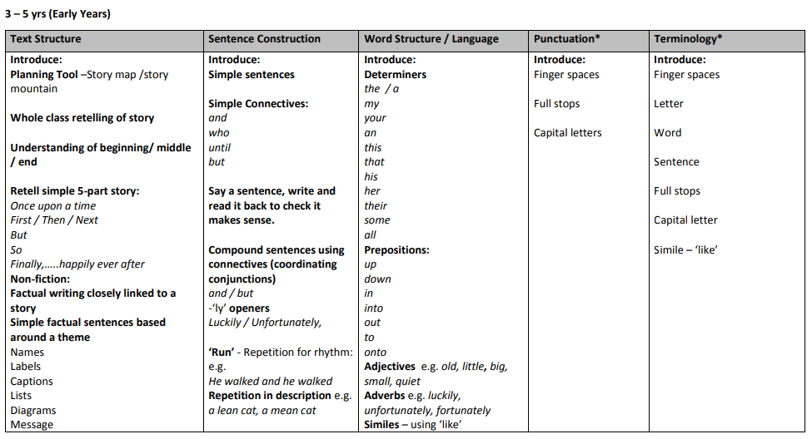

Slide 5
T4W: Progression: Year 1

Slide 6
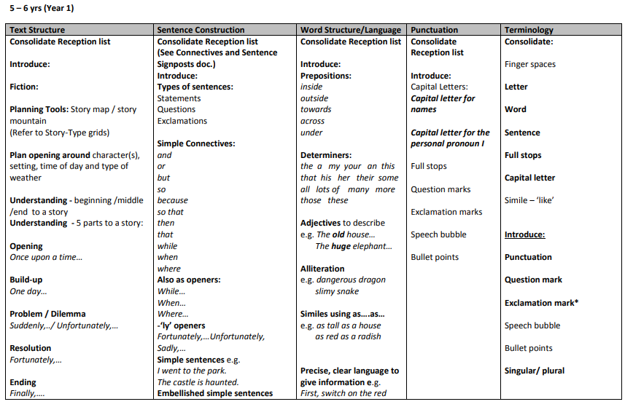

Slide 7
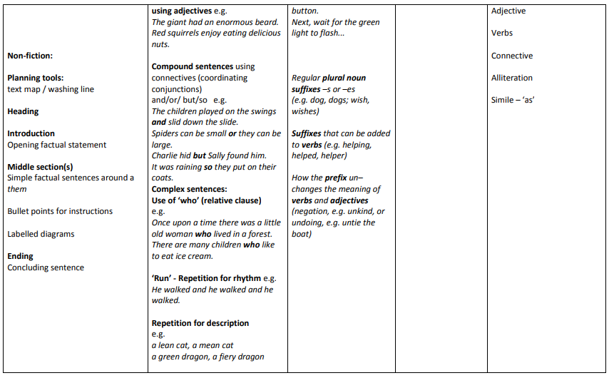

Slide 8
T4W: Progression: Year 2

Slide 9
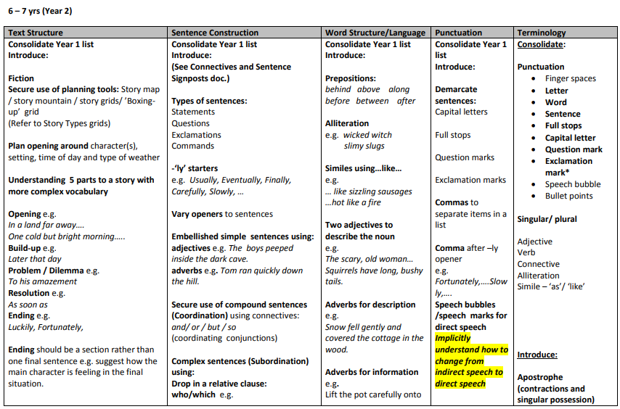

Slide 10
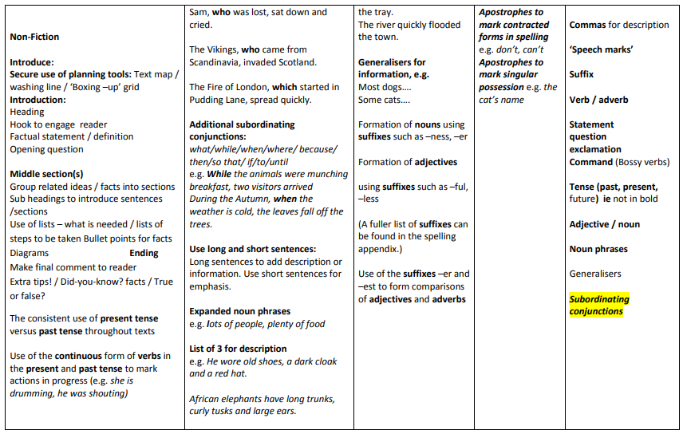

Slide 11
T4W: Progression: Year 3

Slide 12
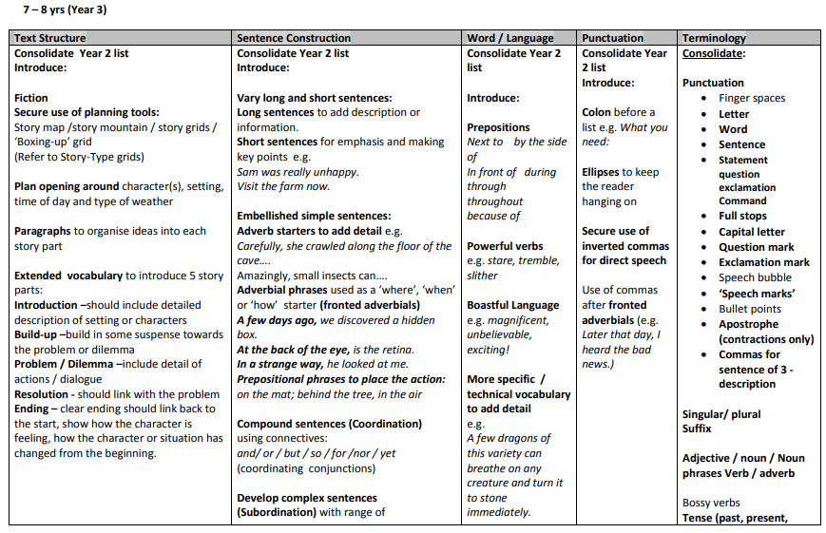

Slide 13
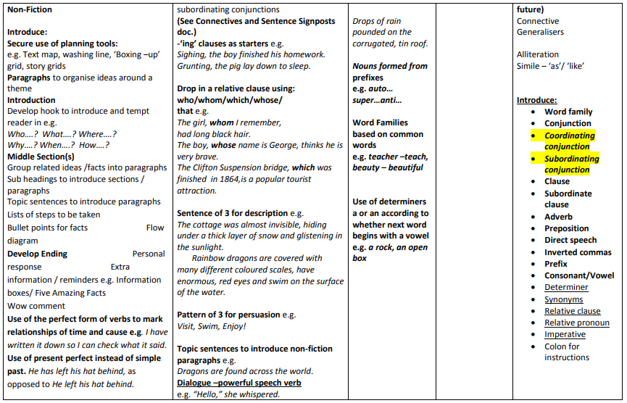

Slide 14
T4W: Progression: Year 4

Slide 15
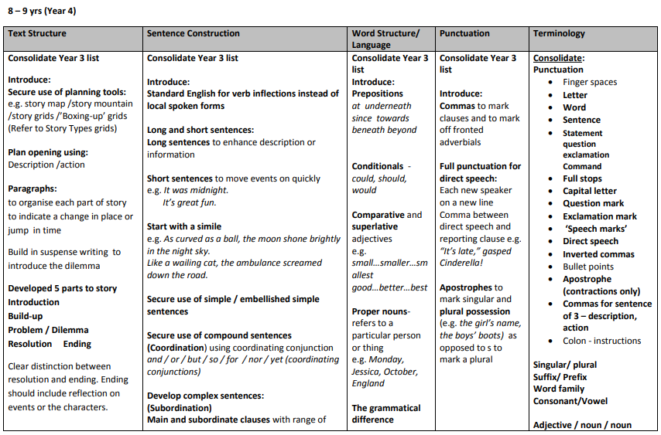

Slide 16
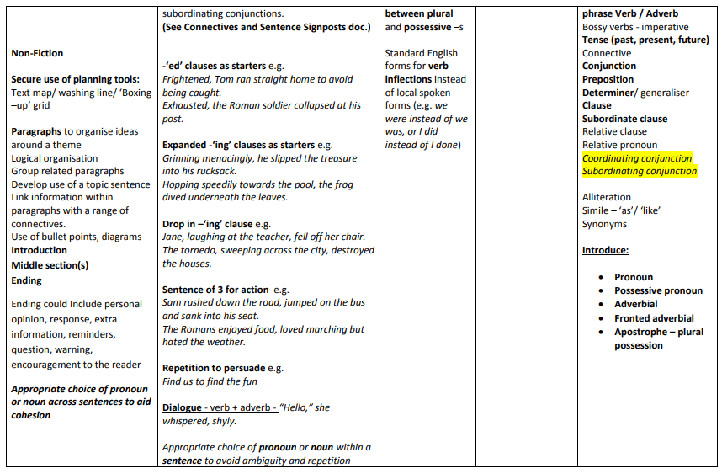

Slide 17
T4W: Progression: Year 5

Slide 18
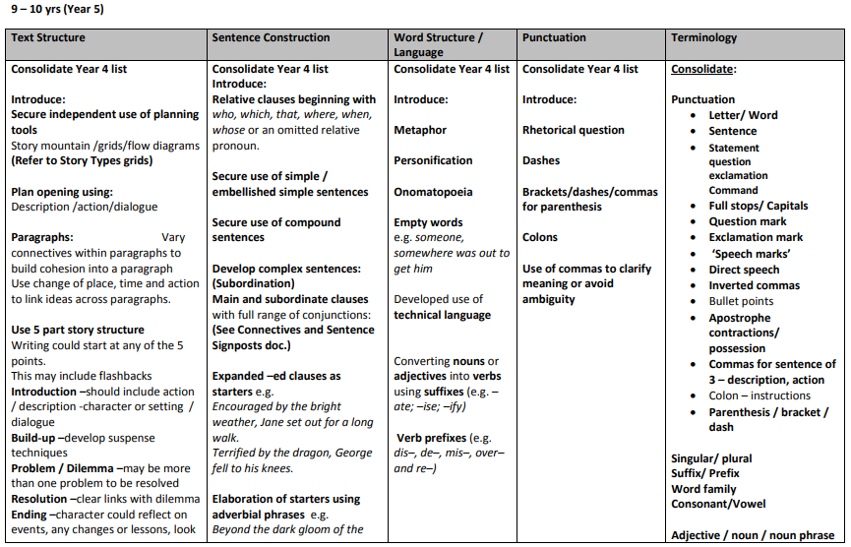

Slide 19
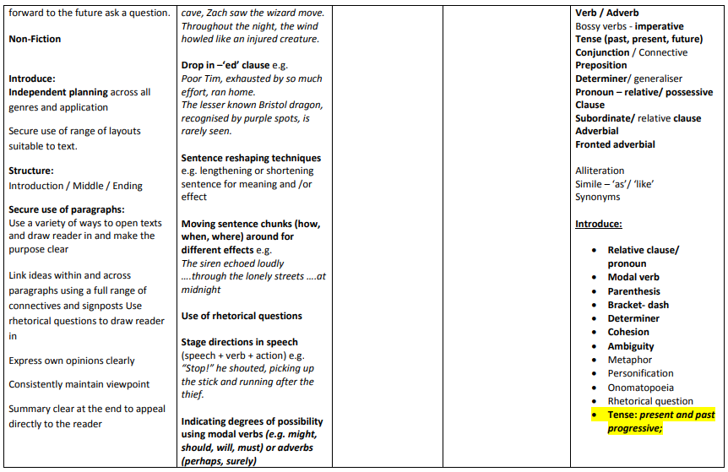

Slide 20
T4W: Progression: Year 6

Slide 21
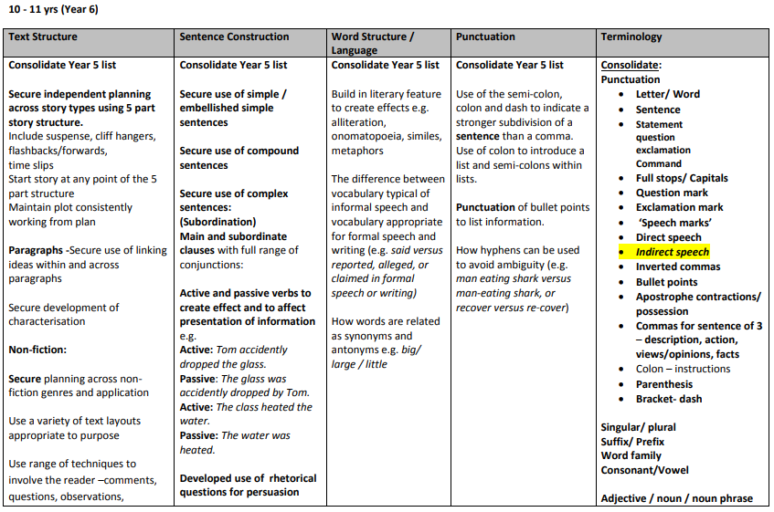

Slide 22
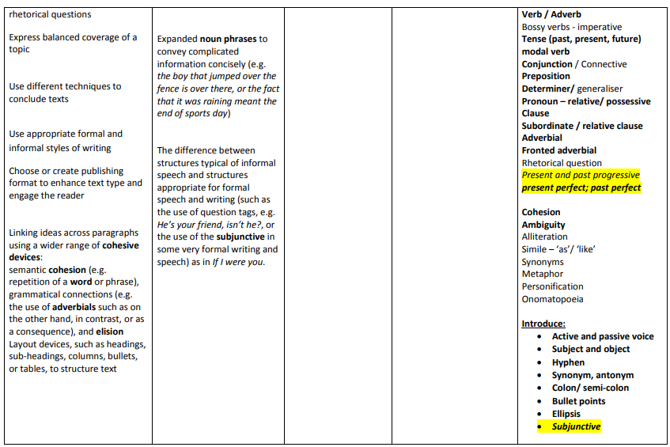

Slide 23
T4W: Progression: KS3- Advanced

Slide 24
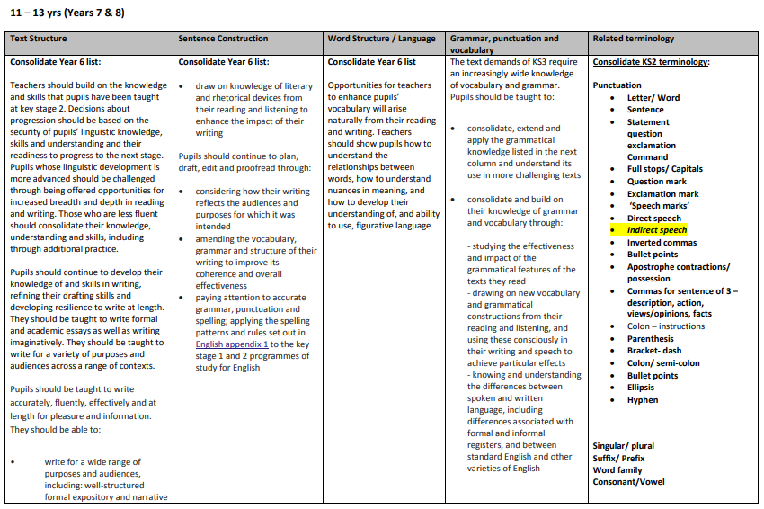

Slide 25
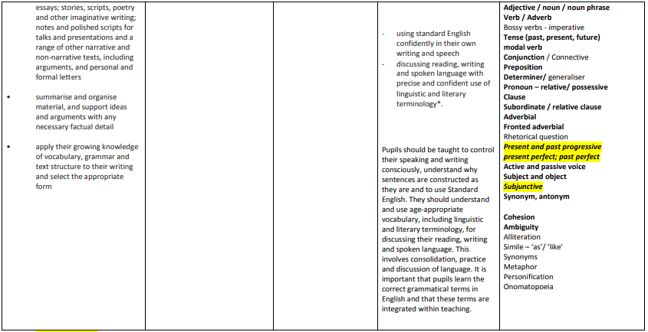

Slide 26
T4W: Poetry Toolkit

Slide 27
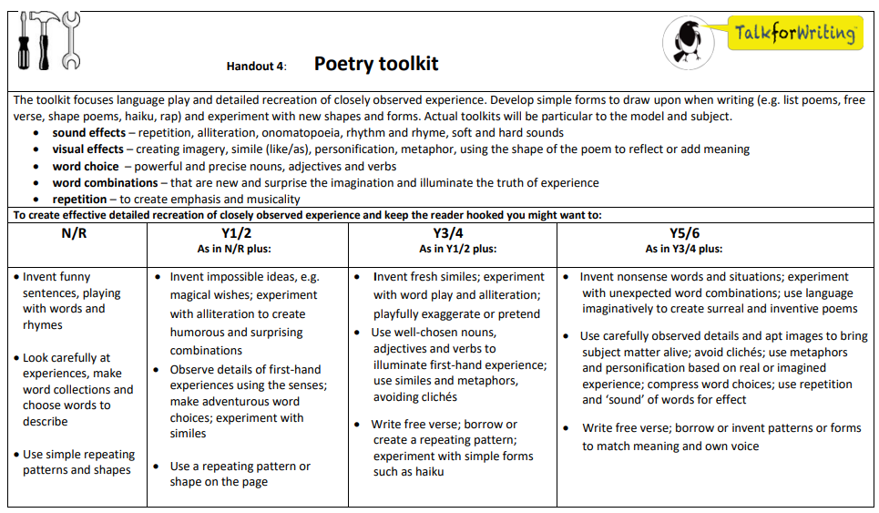

Slide 28
