Slide 1
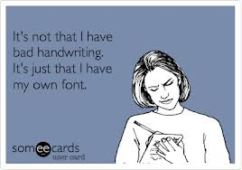


Handwriting

Slide 2

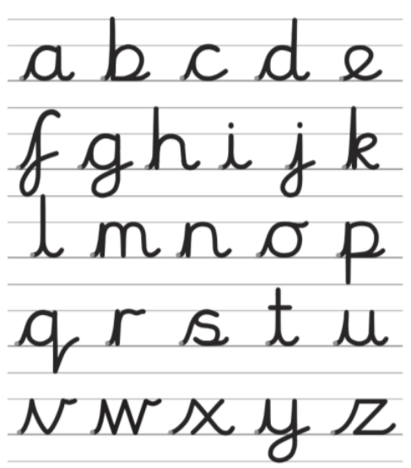

Slide 3
Branston Junior Academy- Handwriting Scheme of Work
There are four key types of joins:
Diagonal joins to letters without ascenders e.g. ai, ar, un
Diagonal joins to letters with ascenders e.g. ab, ul, it
Horizontal joins to letters without ascenders e.g. ou, vi, wi
Horizontal joins to letters with ascenders e.g. ol, wh, ot
Planning key:
Tortoise Letters (stay down low) | a,c,e,i,m,n,o,r,s,u,v,w,x,z
Giraffe Letters (ascenders) | b,d,f,h,k,l,t
Monkey Letters (descenders) | g,j,p,q,y
Joins
Handwriting sessions:
Each class will have at least one handwriting session a week (of at least 10 minutes teaching time and 20 minutes directed activity)
Classes may have additional handwriting sessions focusing on phonics/ spelling joins.
Children who demonstrate accurate and clear handwriting in both handwriting sessions and in all subject books (including topic and science) will be awarded a handwriting pen and certificate and as a result will be allowed to use pen within their work.
Children struggling with handwriting will be referred to the SENCo for possible intervention.
Wk | Year 3/4 | Year 5/6
1 | a,c,e,i | a,c,e,i,m,n,o,
2 | m,n,o, | r,s,u,v,w,x,z
3 | r,s,u,v | b,d,h,k,l
4 | w,x,z | f,t
5 | b,d, | g,i,p,q,y
6 | h,k,l | Capital letters
Term 1

Slide 4
Wk | Year 3/4 | Year 5/6
1 | f,t | ch,sh,th
2 | g | cl,fl,sl
3 | j,p | at,ah,all
4 | q,y | im,in
5 | Look at capitals | ee,ay,ai
6 | ch, sh | cr,tr,dr
Term 2
Wk | Year 3/4 | Year 5/6
1 | th | wh,oh
2 | cl, sl | of,if
3 | fl | oy,op
4 | Handwriting assessment | id,ig
5 | at | ime,ine
6 | ah | one,ome
Term 3
Wk | Year 3/4 | Year 5/6
1 | all | Extended
2 | im,in | Extended
3 | ing | Extended
4 | ee | Extended
5 | ai, ay | Extended
6 | Handwriting assessment | Extended
Term 4

Slide 5
Wk | Year 3/4 | Year 5/6
1 | cr | Extended
2 | tr | Extended
3 | dr, br | Extended
4 | Handwriting assessment | Extended
5 | oh | Extended
6 | of,if | Extended
Term 5
Wk | Year 3/4 | Year 5/6
1 | Handwriting assessment | Extended
2 | wh | Extended
3 | oy, op | Extended
4 | id, ig | Extended
5 | ime, ine | Extended
6 | one, ome | Extended
Term 6

Slide 6

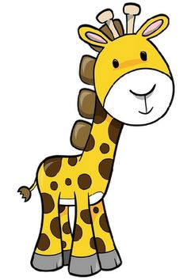

Tortoise Letters
Stay down low
a,c,e,i,
m,n,o
r,s,u,v,w,x,z
Giraffe Letters
Ascenders
b,d,f,h,k,l,t
Monkey Letters
Descenders
g,j,p,q,y

Slide 7
__________________________________________________________________________________________________________________________________________________________________________

